Slide 1
YouELect
Elect smart

Slide 2

Our Objective
Our motive is to design an application that makes election conduction and voting a lot easier then it used to be by utilizing the strength of internet.
Also , we look forward to provide deep insights of any election that will be conducted on our platform, along with providing quick results within seconds.

Slide 3
Our Progress
Till now, we have worked on designing the frontend for our project.
Home Page has been designed.
Pages for registration and login had been designed.
Pages are being served on local host with the help of Node.js and Express.

Slide 4
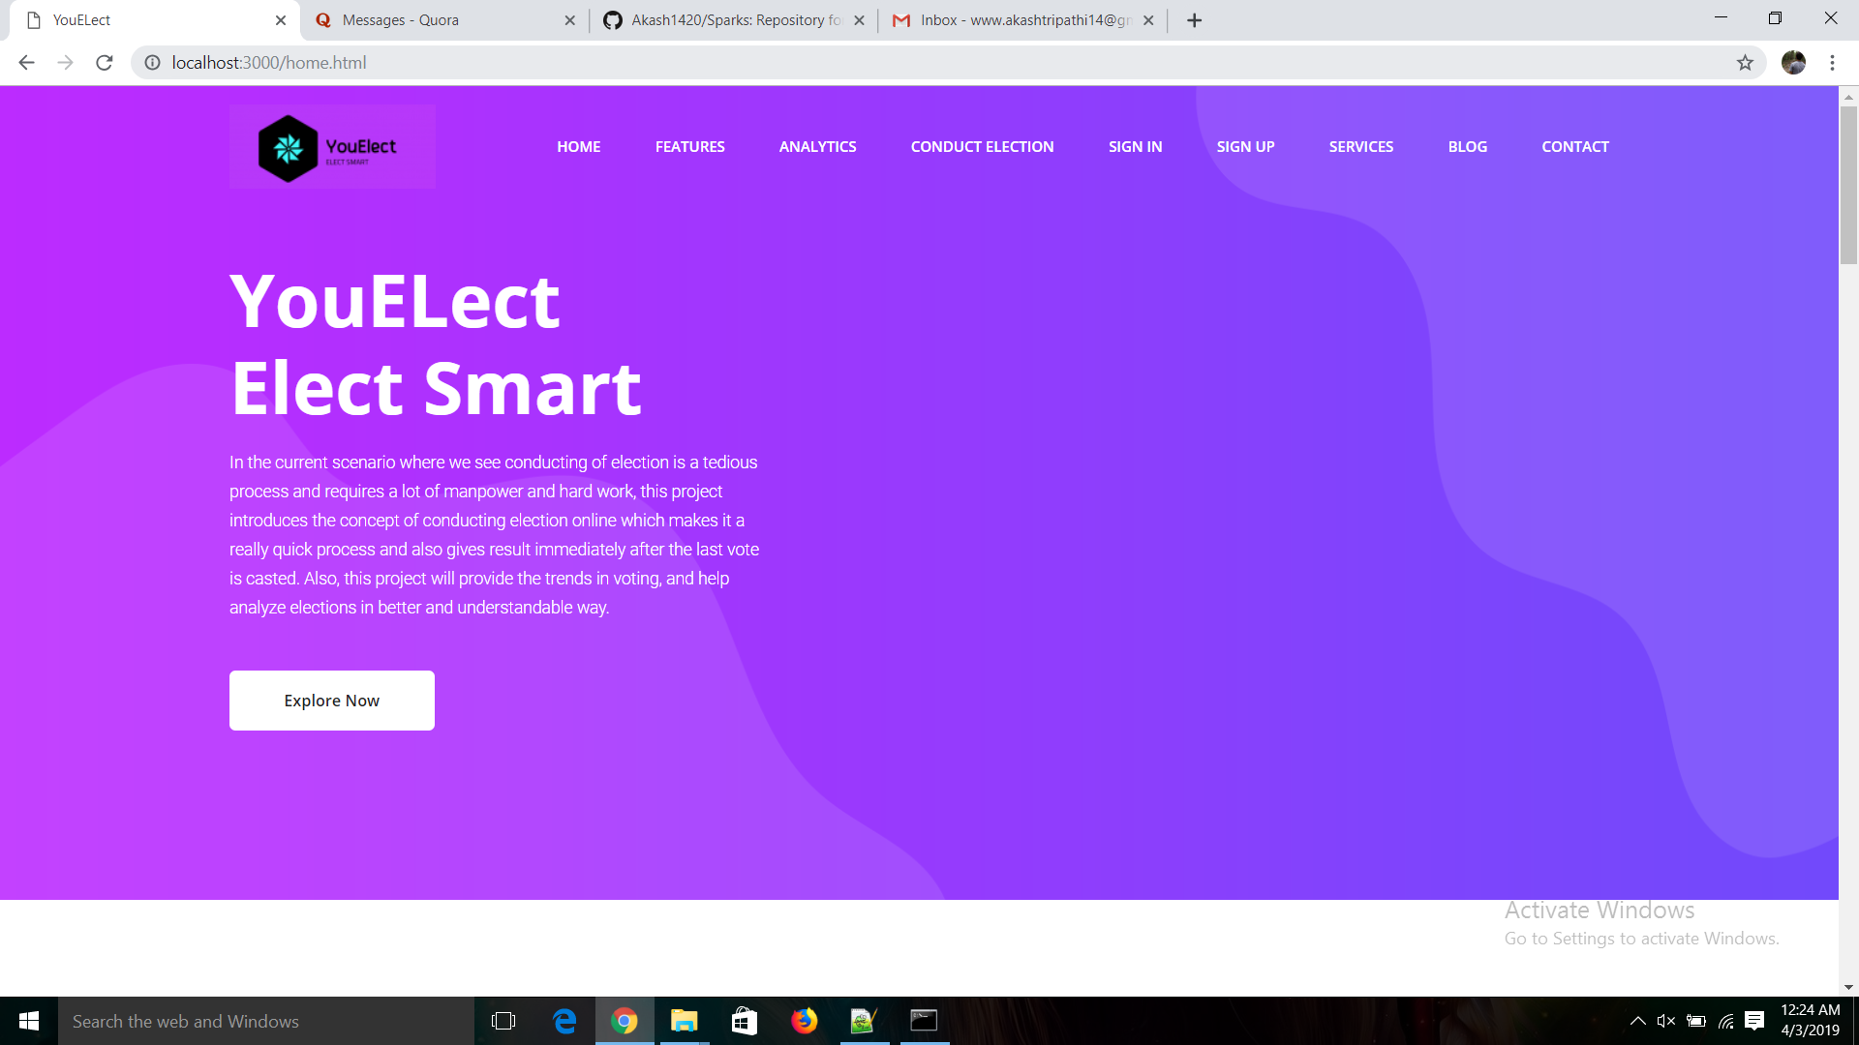
HOME PAGE

Slide 5
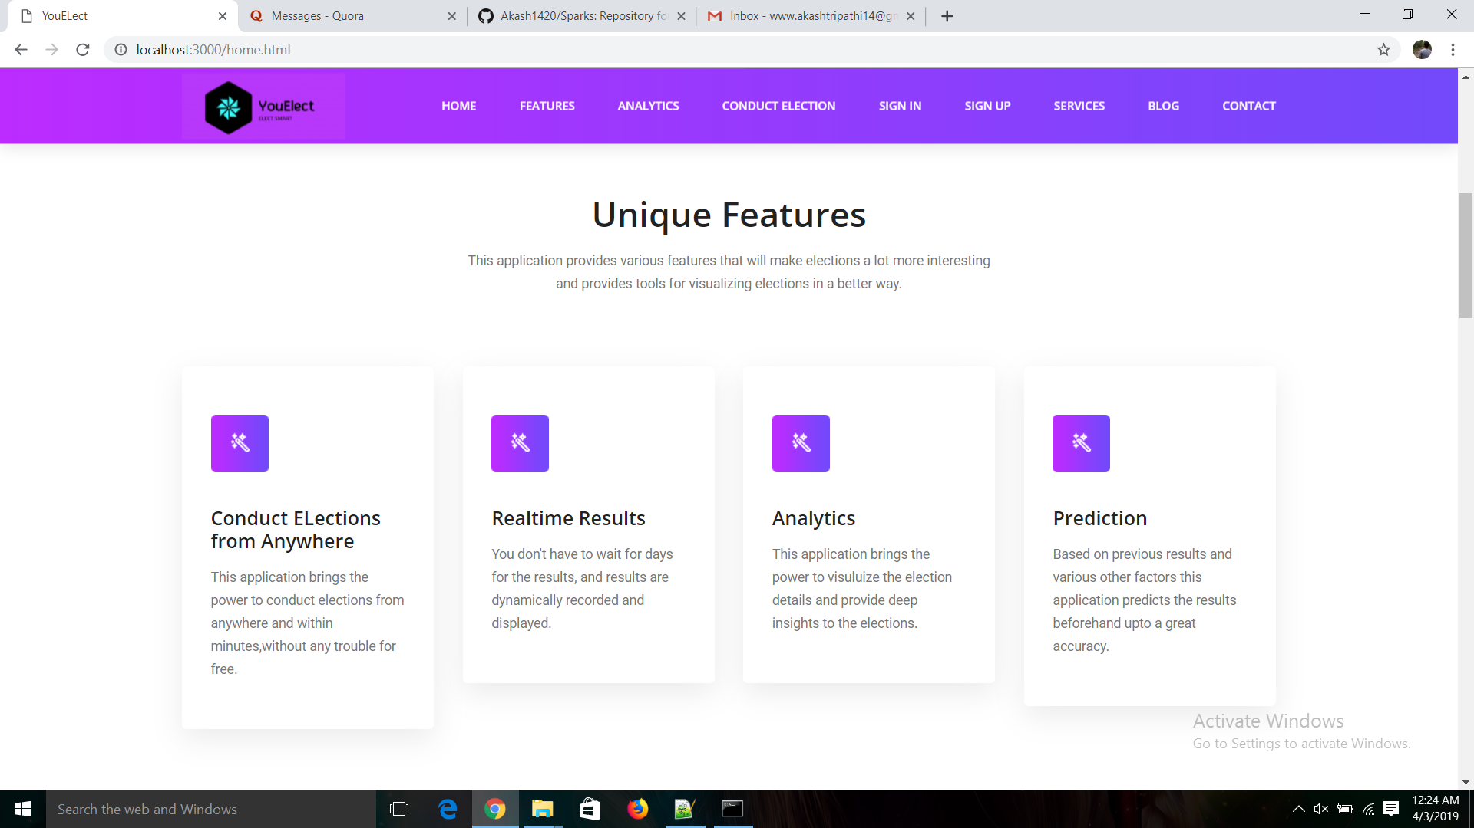

Slide 6
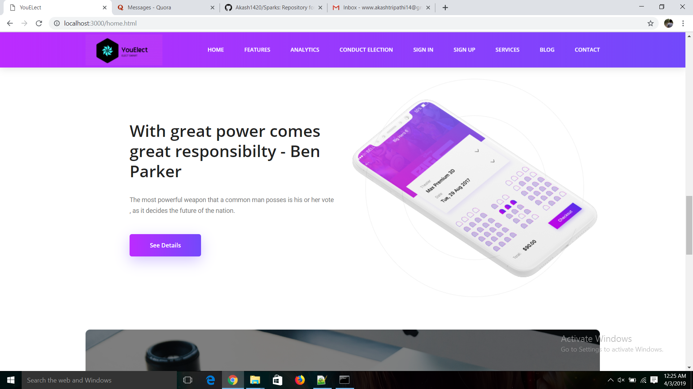

Slide 7
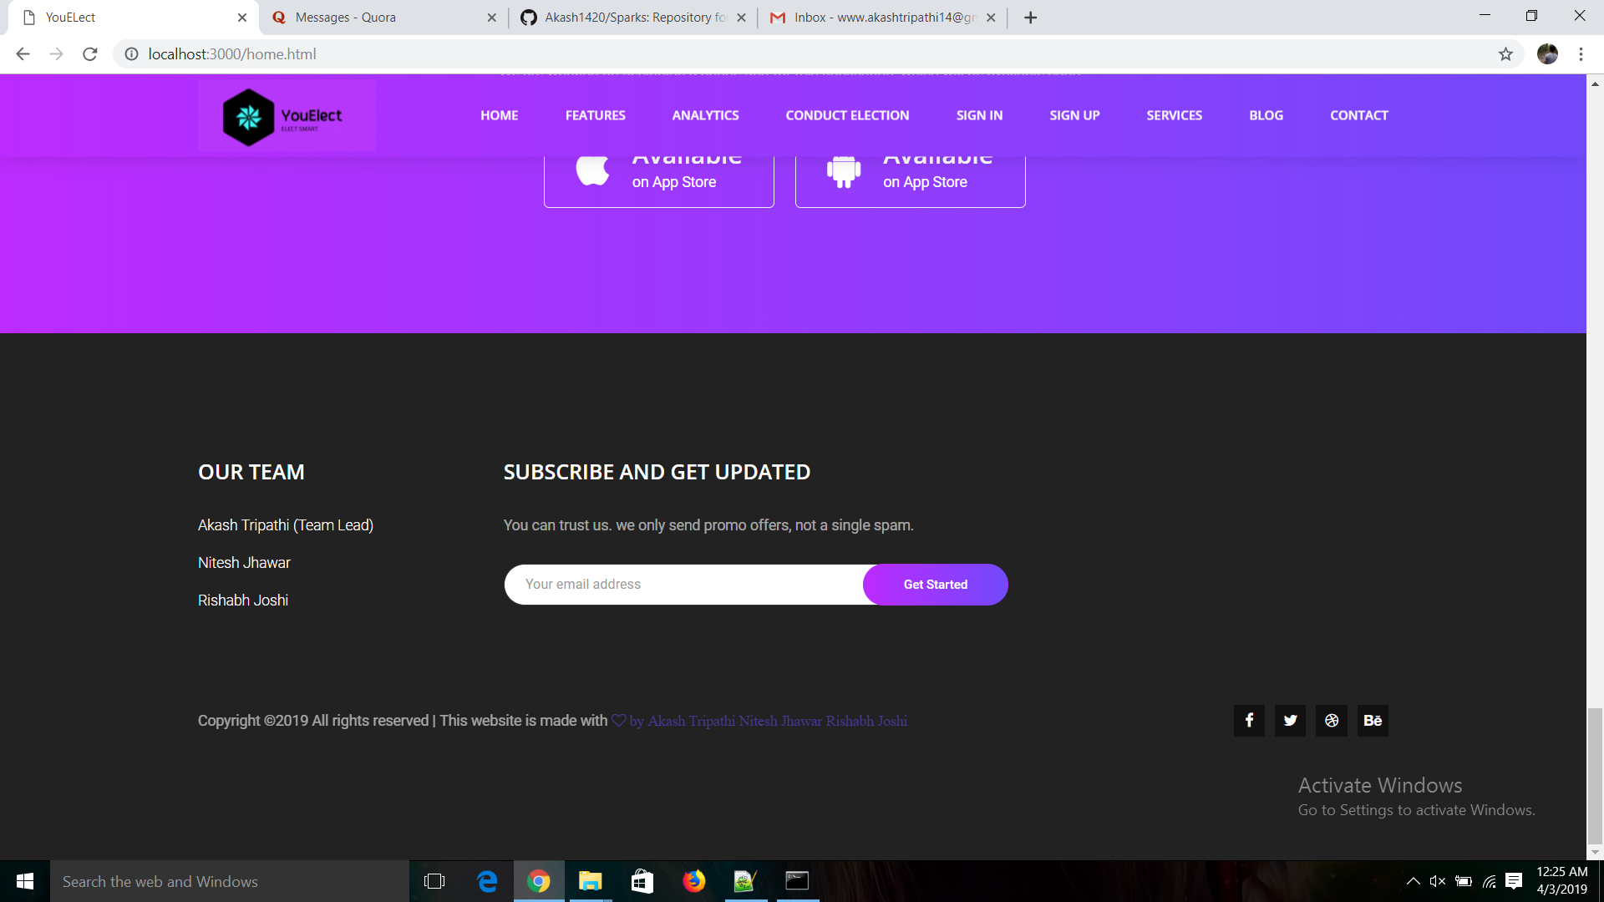

Slide 8
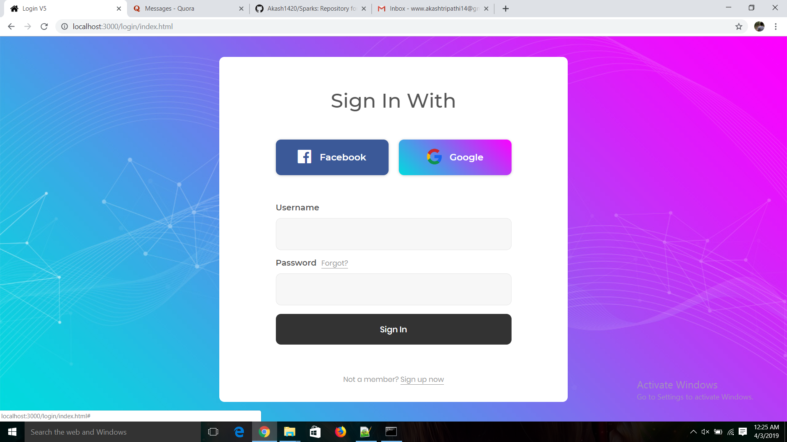

Slide 9
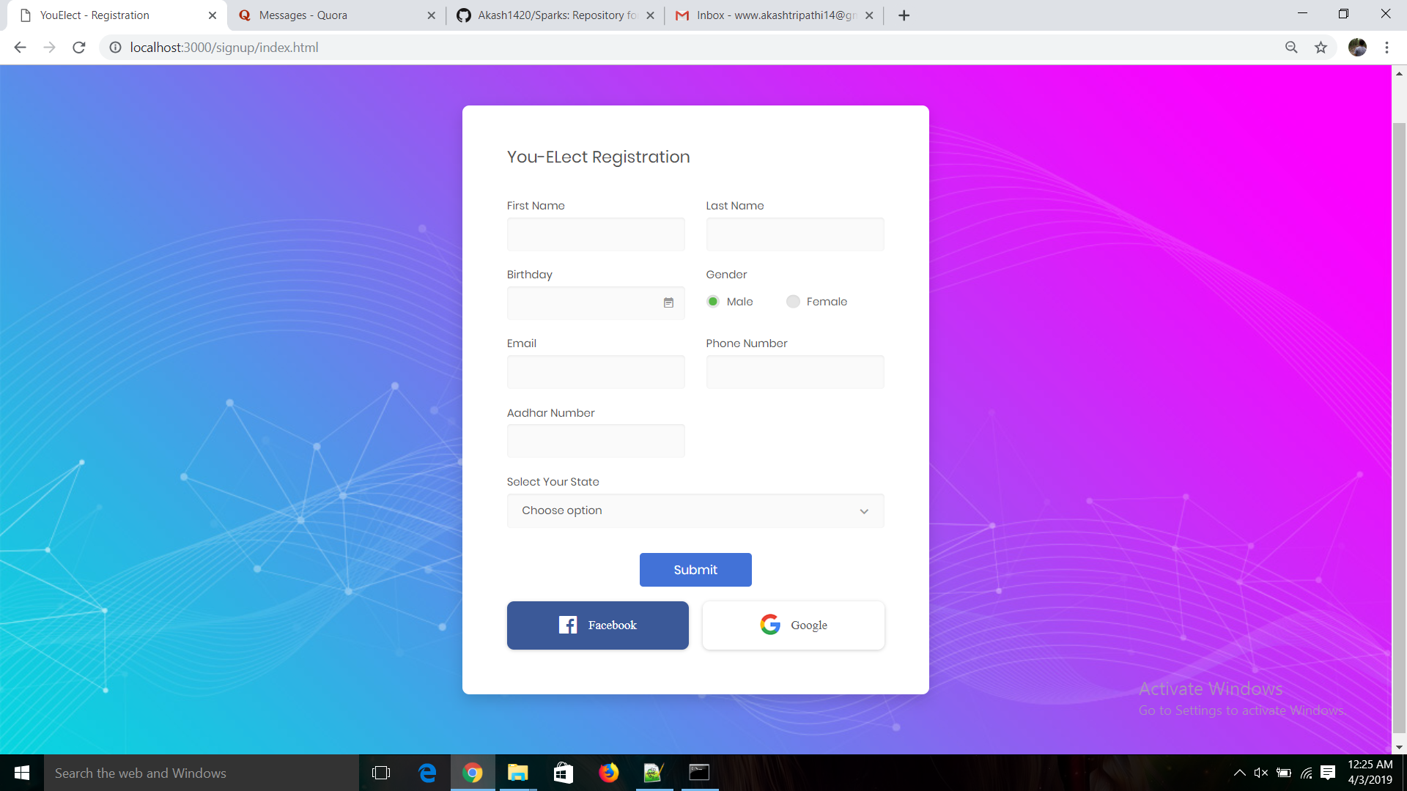

Slide 10
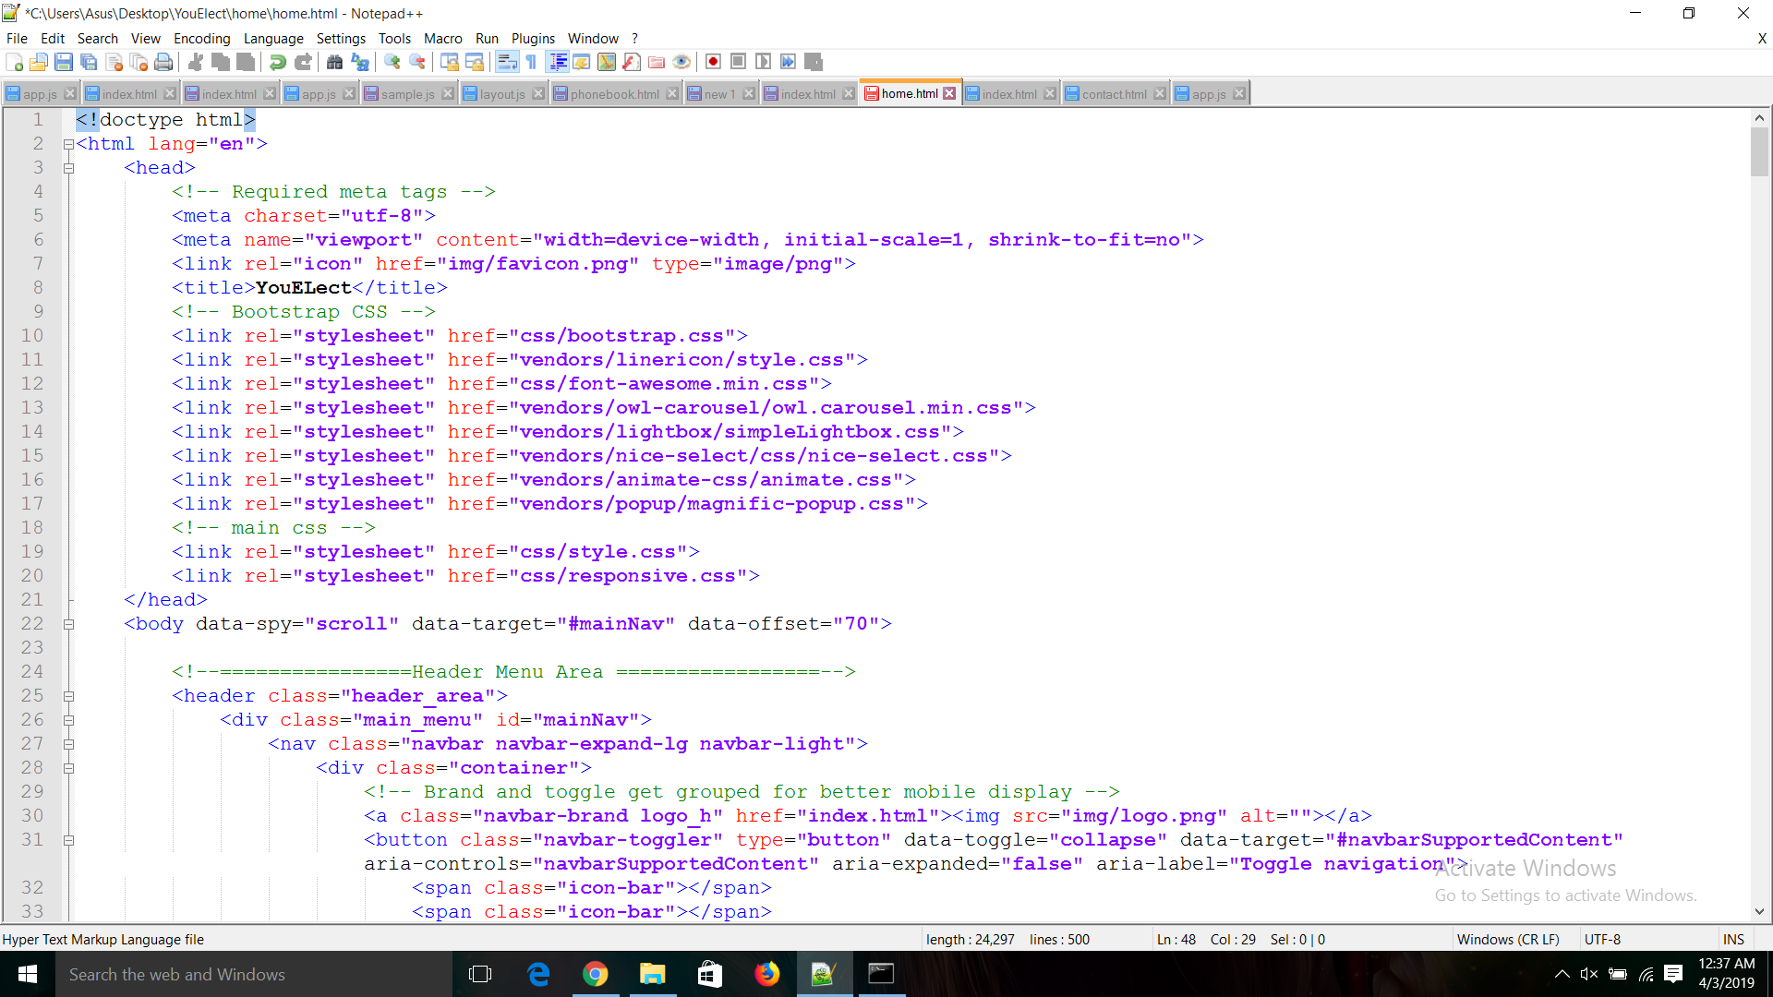
A little Sneak Peek to our code

Slide 11
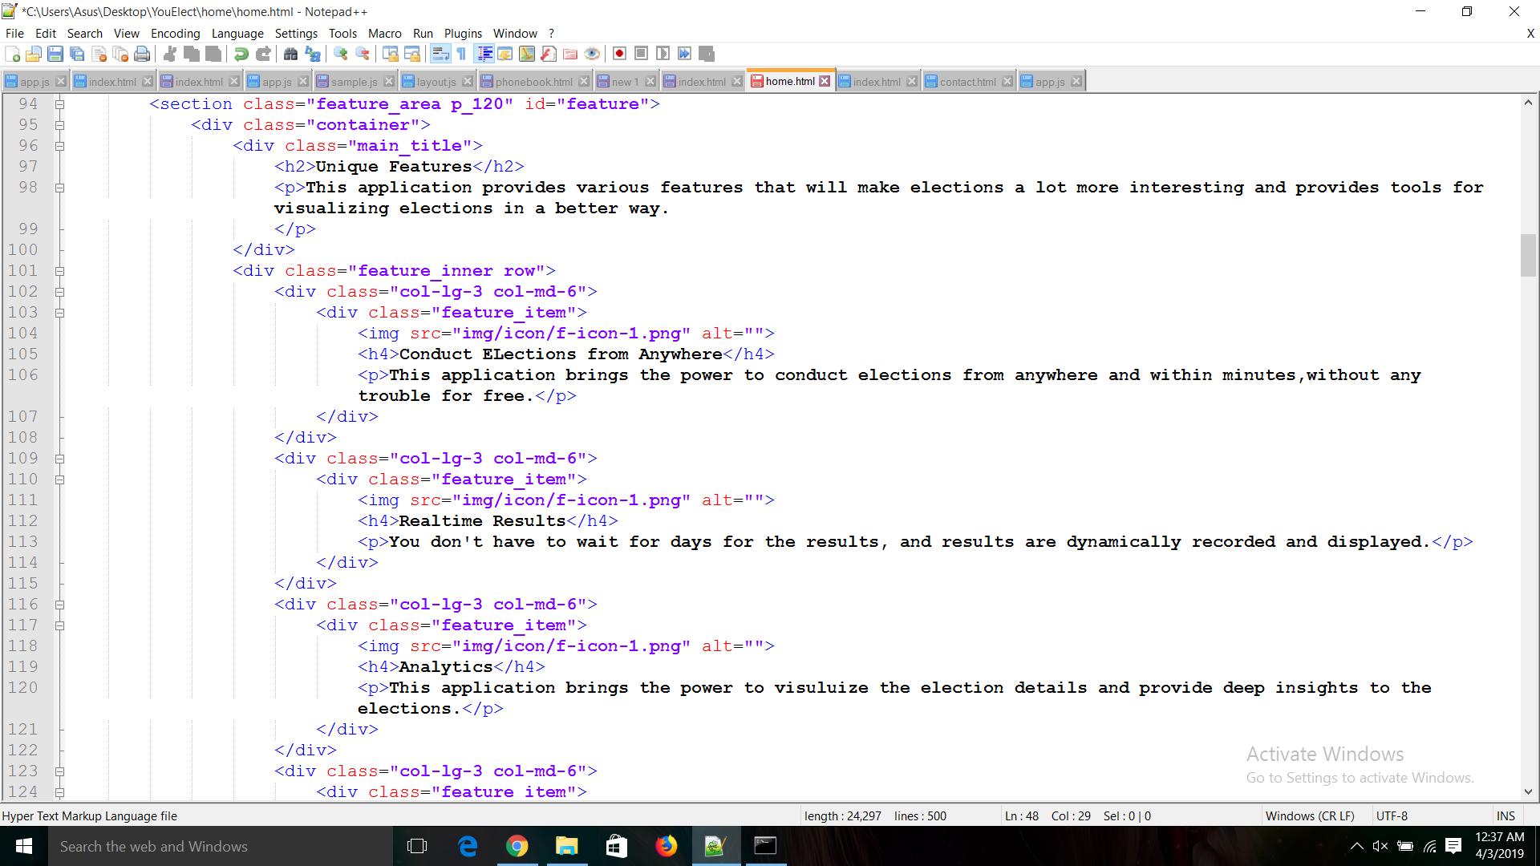

Slide 12
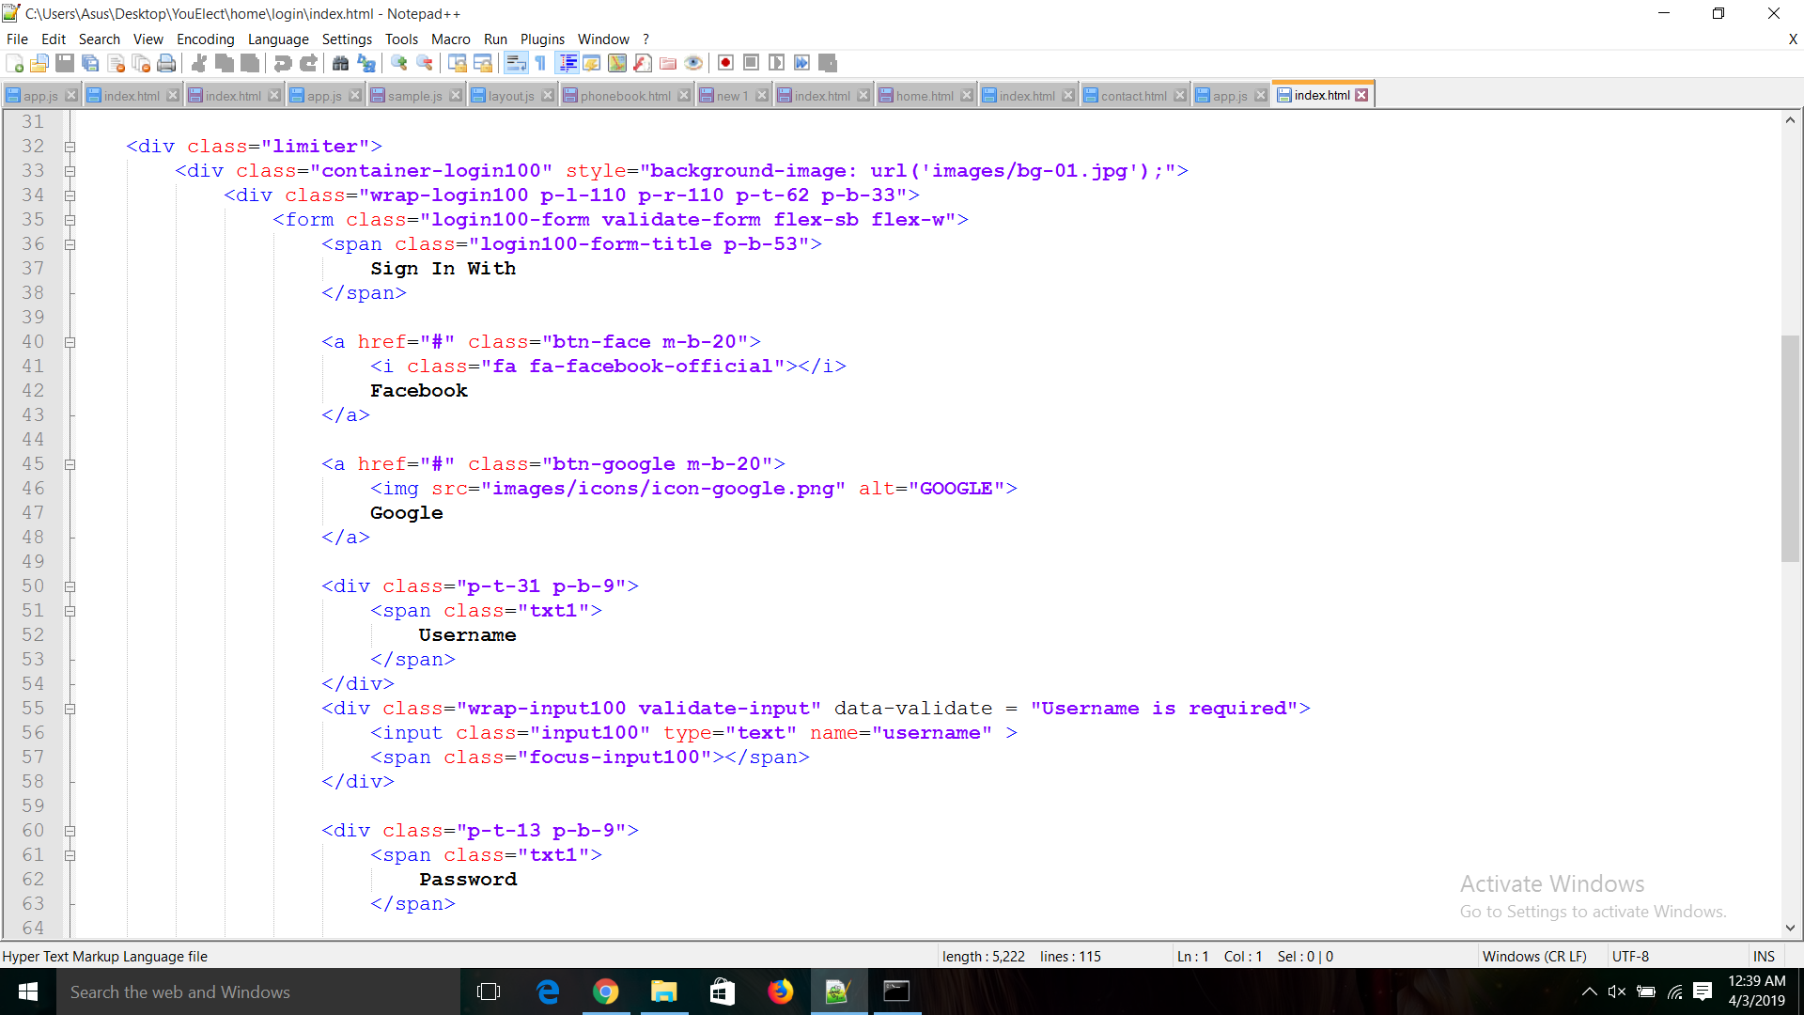

Slide 13
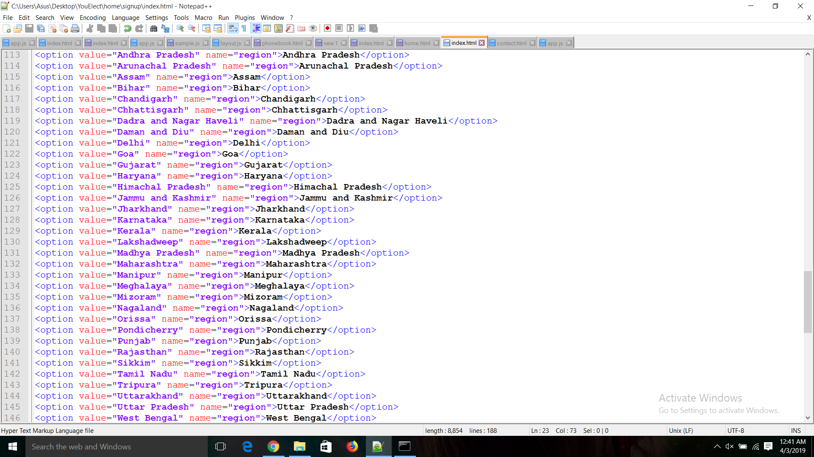

Slide 14
Our Team
Rishabh Joshi Akash Tripathi Nitesh Jhawar (Project Leader)

Slide 15
Thank You

